Slide 1
THE presentation ON STATIC AC CIRCUIT BREAKER USING TRIAC WITH GSM AGNIHOTRI POLYTECHNIC, NAGTHANA GUIDED BY CHANDRAKANT V. BAMRATKAR
FROM
SURAJ D. BAGEKAR
ABHILASH.A.THAKRE
SURAJ NASRE
NITESH CHOUDHARI
VISHAL AMBHORE
SAGAR VYAPARI

Slide 2
CONTENTS
INTRODUCTION
BLOCK DIAGRAM
CIRCUIT DIAGRAM
WORKING
COMPONENTS AND ITS DISCRIPTION
ADVANTAGES
DIS-ADVANTAGES
APPLICATIONS
CONCLUSION
FUTURE ENHANCEMENT
TESTING AND RESULT
REFERENCES

Slide 3
INTRODUCTION
The purpose of this this project, is to make a protective device for protecting electrical equipments connected in electrical circuit from fault conditions.
We all know that the electrical load connected in electrical installation have been suffer from high voltage, over current, overload condition, etc.
Hence it is very essential to protect these equipment by suitable circuit breaker which disconnects the load from faulty section without affecting healthy part.
The static A.C. circuit breaker using TRIAC has been protect the electrical load when fault condition is occured.

Slide 4
BLOCK DIAGRAM
CURRENT SENSOR
CONTROLLER
GSM MODULE
LOAD
THYRISTOR
CIRCUIT

Slide 5
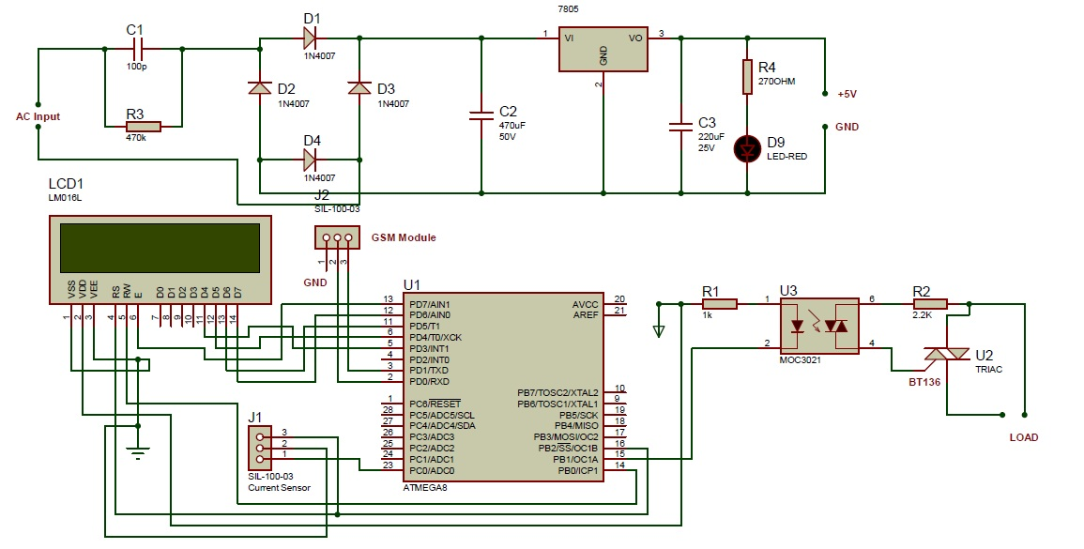
CIRCUIT DIAGRAM

Slide 6
WORKING
In our project we build an “A.C. STATIC CIRCUIT BREAKER USING TRIAC WITH GSM” which is totally depend on current sensor, AVR microcontroller and the TRIAC. Here, the TRIAC is used as a switch used to control the switching operation of the load in fault as well as normal working condition of the load. The TRIAC is power electronic device used to controlled high power and high current equipments. We make a fast switching of TRIAC with microcontroller and current sensor element.
The current sensor is connected to microcontroller and microcontroller is connected to the TRIAC through transistor BC547 and Opto-isolator and the TRIAC is connected to the load which determine the switching “ON and OFF” of load to supply power.
The current sensor is connected to supply and AVR microcontroller is sense the supply current value and generate the output of 1amp=0.185mV and this output is given to the microcontroller. The programming is program in microcontroller is in “C” language the output voltage of current sensor is compaired with the reference value which contain in programming. If the supply current value is less than the reference value the continue power is given to gate of the TRIAC through transistor and opto coupler. Hence, the load is remain ON and safe due to rated current is fed from supply.

Slide 7
If the overload or any fault condition is occurred then the supply current is increases than rated current value. This fault current value is sense by sensor and give output to microcontroller the microcontroller compaire this value with reference and this value is greater than rated value of current. Hence, microcontroller is disconnected supply to gate of TRIAC through transistor and opto-isolator and thus the load is safely disconnect from the supply and it protected from fault. The switching time of the TRIAC is 200 μsec to 300μsec.
The purpose of opto-isolator is that if fault is generated on load side then it will damage the microcontroller section. The opto isolator is used to isolate both section of microcontroller and load as there is no electrical connection between them only optical connection is their. Hence, opto isolator is used to protect the microcontroller section.
By using GSM module it sends the massage to our mobile which indicates the condition of circuit weather it turn off or on.
If the circuit is tripped due to overload or any fault condition condition then GSM send the massage on mobile number is that “supply is turn of due to overload”.

Slide 8
COMPONENTS
Current sensor
AVR micro-controller
Opto-isolator
LCD
Triac
GSM modem

Slide 9
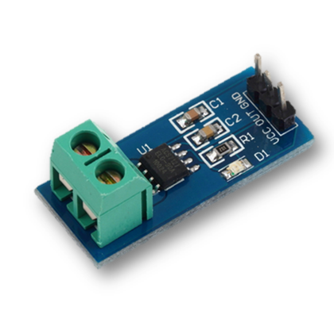
CURRENT SENSOR

Slide 10
DISCRIPTION
The current sensor chips: ACS712ELC-05B;
The module can be measured plus or minus 5 amps, corresponding to the analog output of 185 mV / A;
There is no the detection current through, the output voltage is VCC/2 .
The o/p of currnt sensor given to AVR.

Slide 11
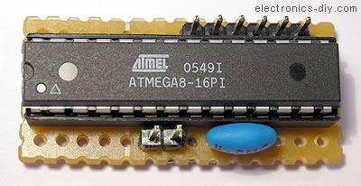
MICRO-CONTROLLER

Slide 12
DISCRIPTION
The micro-controller AVR is stand for ‘ADVANCE VIRTUAL RISC’.
The AVR atmega 8 micro-controller is used.
The o/p of current sensor given to ADC of AVR which convert analog i/p into digital .
This value is compaired with reference value in micro controller.
If it is greater than rated current value the microcontroller will disconnect the signal given to opto-isolator which disconnect the load from supply through TRIAC.

Slide 13
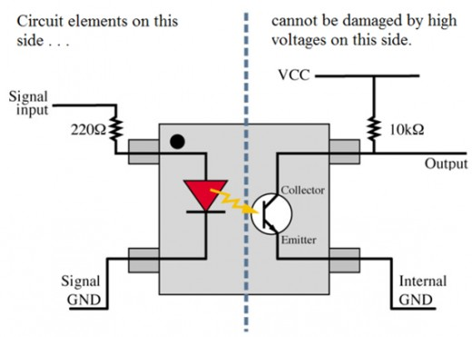
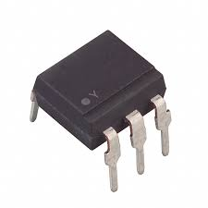
OPTO-ISOLATOR

Slide 14
DISCRIPTION
The opto-isolator is consists of LED and and a photo diode.
In normal condition the AVR supply is continuoes meet to the isolator and led is emmits light and photo diode received the light thus opto-isolator acts as a short circuit and conducts current through it and thus continues current is fed to the gate of TRIAC and thus the load is fed by required supply.
When load is increased the current through load is increased and thus the current sensor gives signal to AVR and AVR compaire this fault current value is greater than rated value.
Hence, the AVR disconnects the supply to opto isolator and system is protected.

Slide 15
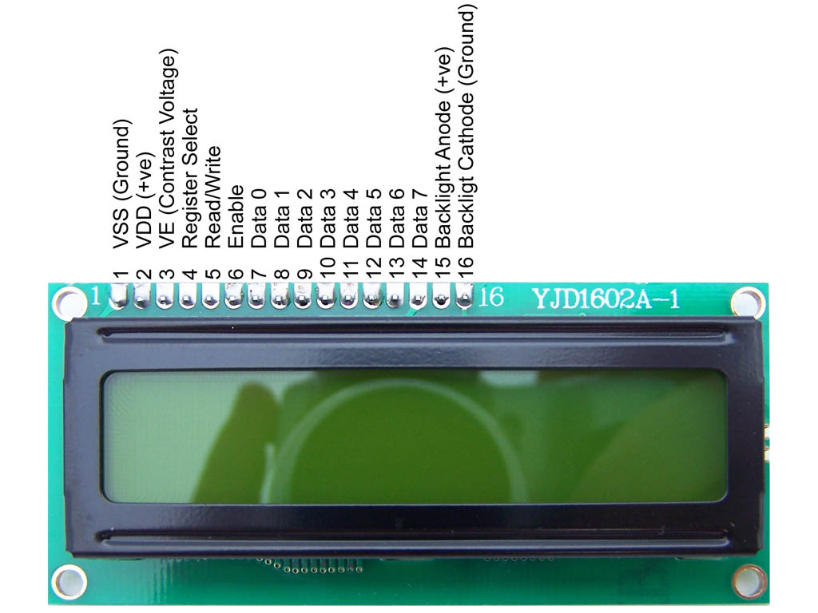
lcd

Slide 16
DISCRIPTION
LCD (Liquid Crystal Display) screen is an electronic display module and find a wide range of applications. A 16x2 LCD display is very basic module and is very commonly used in various devices and circuits. These modules are preferred over seven segments and other multi segment LEDs. The reasons being: LCDs are economical; easily programmable; have no limitation of displaying special & even custom characters (unlike in seven segments), animations and so on.
A 16x2 LCD means it can display 16 characters per line and there are 2 such lines. In this LCD each character is displayed in 5x7 pixel matrix. This LCD has two registers, namely, Command and Data.
The command register stores the command instructions given to the LCD. A command is an instruction given to LCD to do a predefined task like initializing it, clearing its screen, setting the cursor position, controlling display etc. The data register stores the data to be displayed on the LCD. The data is the ASCII value of the character to be displayed on the LCD.

Slide 17
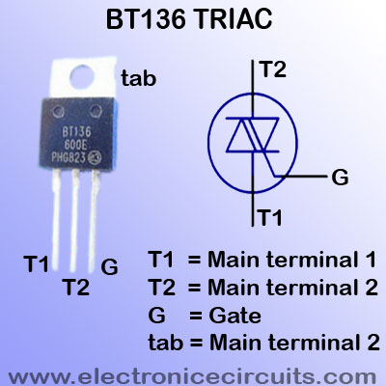
TRIAC

Slide 18
DISCRIPTION
The TRIAC is power electronic device used to control the high voltage, high current equipments.
In normal condition, the continues supply is fed to triac which connect the load in supply line.
In faulty condition, thethe AVR disconnects the signal and and cannot fed supply to load
Thus sustem is protected from fault.

Slide 19
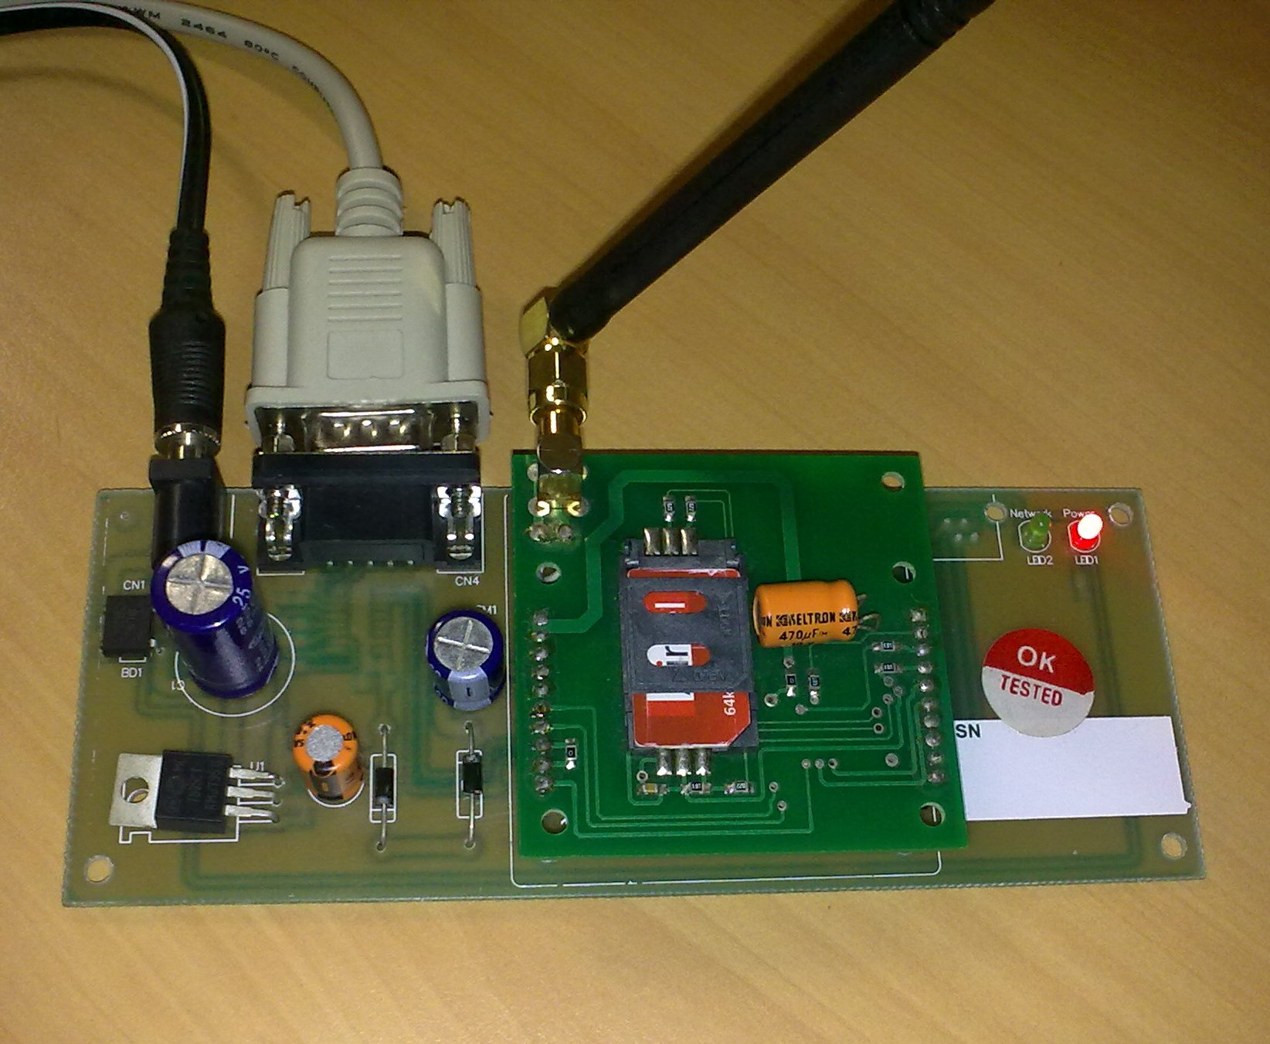
GSM MODEM

Slide 20
DISCRIPTION
The GSM module is connected to the AVR.
When circuit is tripped due to fault condition. The GSM send the massage to mobile which indicate the condition of circuit i.e. wheather it turn ON or OFF.

Slide 21
ADVANTAGES
Fault clearing time is very fast.
Totally automatic controlled.
It is very easy to operate the system through GSM.
Losses in AVR, TRIAC etc are very minimum.
Less maintenance required.
System is very light.

Slide 22
APPLICATIONS
It used in each an every electrical installation for protection.
For protecting home appliances.
Protection for induction motor.
Protection for transformer etc..

Slide 23
CONCLUSION
In this project, the operation of current sensor, AVR, opto-isolator, Triac, GSM module is understand.
The load is cut off at exact value of fault current.
Further using GSM module the massage is send to mobile indicates the load is tripped or connected.
Due to this project, the electrical load are safely disconnected from supply in faulty condition.

Slide 24
FUTURE ENHANCEMENT
In this project we can only receive a massage through GSM to mobile which indicates the condition of circuit weather is turn off or on.
The future enhancement is that, further we can controlled the operation of this circuit through the mobile.
If circuit is tripped due to overload, then GSM send the massage to mobile that “supply is turn off due to overload.
In the future enhancement we send the massage from mobile to the GSM module that “turn on the supply” then the circuit is reconnects the load across supply.
Other future enhancement is that we can connect the bluetooth model with this circuit breaker and same control is possible with this bluetooth model.
Hence it can be serve the process where the network is not available.

Slide 25
TESTING AND RESULT
The circuitry is design to act as an circuit breaker was tested on different domestic load like T.V. set, refrigerator, 1-phase induction motor, 100watt bulbs, electric iron with different current settings. The time period of fault clearance was observed during testing and result and result detail are as follows;
Tested Equipments:-
T.V. set
Pre-fault condition:-
Set values in microcontroller
Current (I) = 1Amp
Voltage (V) = 230volt
After Fault condition:-
Current (I) = 1.4Amp
Voltage (V) = 164volt
Time (T) = 2sec
Refrigerator
Pre-fault condition:-
Set values in microcontroller
Current (I) = 2Amp
Voltage (V) = 230volt
After Fault condition:-
Current (I) = 2.1Amp
Voltage (V) = 219.05volt
Time (T) = 2sec

Slide 26
3) 1-phase induction motor
Pre-fault condition:-
Set values in microcontroller
Current (I) = 5Amp
Voltage (V) = 230volt
After Fault condition:-
Current (I) = 5.8Amp
Voltage (V) = 198volt
Time (T) = 2sec
100watt bulbs
Pre-fault condition:-
Set values in microcontroller
Current (I) = 9Amp
Voltage (V) = 230volt
After Fault condition:-
Current (I) = 9.1Amp
Voltage (V) = 242volt
Time (T) = 2sec
Electric Iron
Pre-fault condition:-
Set values in microcontroller
Current (I) = 4Amp
Voltage (V) = 230volt
After Fault condition:-
Current (I) = 4.4Amp
Voltage (V) = 218volt
Time (T) = 2sec

Slide 27
REFERENCES
Advance microprocessor.
Power electronics.
Protective Relays Application Guide, (pages 78-87).
Modern Applied Science Vol 5 for opto isolator.
Ashok Bindra (2000). MEMS based magnetic coil exceed the limitation of opto-isolator.
John Myers (2002). Magnetic coupler in industrial system.
GSM global system for mobile communication.

Slide 28
THANK YOU

